Slide 1
Research Methods
Dr Julia Handl

Slide 2
Today’s session
Learning | Research | Writing
Learning experiences (A1) | What is research? | Presenting a logical argument (A5)
Organization skills (A2) | Generating research ideas (A3) | Writing for different audiences
Smart / critical reading | The research process (A4) | Plagiarism (A6)

Slide 3
Relevance
Taking responsibility for your own learning is essential in a post-graduate degree
Variety of courses / assessment
Individual summer research project
Dissertation + Different styles of reports

Slide 4
Today’s session
Learning | Research | Writing
Learning experiences (A1) | What is research? | Presenting a logical argument (A5)
Organization skills (A2) | Generating research ideas (A3) | Writing for different audiences
Smart / critical reading | The research process (A4) | Plagiarism (A6)

Slide 5
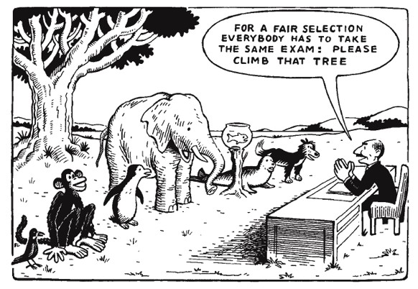
Activity 1: Your learning style

Slide 6
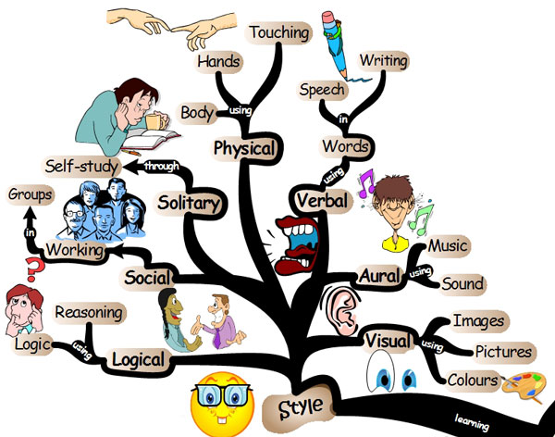

Slide 7
Learning styles
Understand your own learning preferences
Adapt your course to suit you, e.g. make sure to choose appropriate modules, form a study group, identify additional materials, ...
Deep rather than surface learning

Slide 8
Activity 2: Organizing yourself

Slide 9
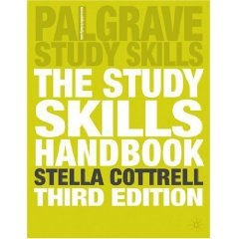
Organization skills
Many people struggle with time management
Often people appear a lot more organized & confident than they really are
Talk to each other and academic staff!
Make use of available resources, e.g. books on study skills

Slide 10
Smart reading
Amount of reading done is
NOT
proportional to the final mark
Do I use reading lists selectively?
Do I find information quickly?
Do I select the relevant parts of the book or paper?
Do I use photocopies (and highlighter pens?)
Do I note down the main ideas?
Do I vary reading speed and method?
Do I know what I am looking for?

Slide 11
Critical reading
Identify the line of reasoning
Critically evaluate the line of reasoning
Relevant and sufficient propositions
Logical progression
False premises
Flawed reasoning
Question surface appearances
Identify evidence in the text
Evaluate the evidence
Identify the writer’s conclusions
Evaluate whether the evidence supports the conclusions

Slide 12
Today’s session
Learning | Research | Writing
Learning experiences (A1) | What is research? | Presenting a logical argument (A5)
Organization skills (A2) | Generating research ideas (A3) | Writing for different audiences
Smart / critical reading | The research process (A4) | Plagiarism (A6)

Slide 13
What is research?
Systematic study and investigation, especially to discover new facts.
Includes conformation of existing facts, review of existing knowledge.
Pure / basic versus applied research.

Slide 14
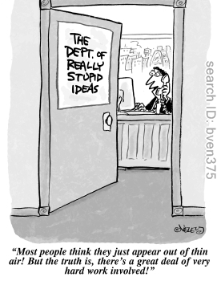
Activity 3: Generating research ideas

Slide 15
Research ideas
Rational thinking | Creative thinking
Examining your own strengths and interests Looking at past project titles Discussion with peers / supervisor Searching the literature Searching the media | Keeping a notebook of ideas (you can start with this NOW!) Exploring personal preferences using past projects Brainstorming
Adapted from M. Saunders, P. Lewis and A Thornhill, Research Methods for Business Students, Prentice Hall, 2007

Slide 16
Aspects of a good research project
Interest
Impact / applicability
Ability to generalize
Originality
Feasibility (access, quality of data, sound methodology, reproducability…)
Well-defined topic and objectives
Objectivity

Slide 17
Research: Induction vs Deduction
What is the key difference between induction and deduction?
You have chosen to undertake your research project following a deductive approach. What factors may cause you to work inductively, although deductively is your preferred choice?

Slide 18
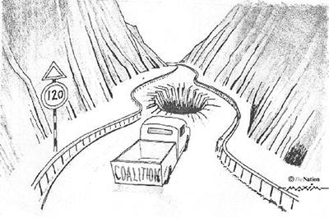
Activity 4: The research process
RESEARCH

Slide 19
Today’s session
Learning | Research | Writing
Learning experiences (A1) | What is research? | Presenting a logical argument (A5)
Organization skills (A2) | Generating research ideas (A3) | Writing for different audiences
Smart / critical reading | The research process (A4) | Plagiarism (A6)

Slide 20
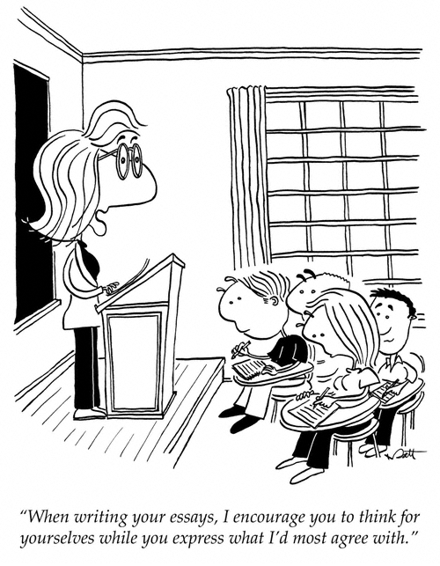
Activity 5: Good writing

Slide 21
Aspects of good writing
Writing = Thinking. Therefore, start early!
Maintain a clear message and logical argument throughout
Clear link between literature review and topic / research questions
Be critical, objective and fair w.r.t. the literature
Balanced and logical structure
Reflection on strengths and limitations

Slide 22
Writing for different audiences
Writing is necessarily catered towards an audience
Assumptions about background knowledge, interests, etc.
In this course, you will encounter three different styles:
Consulting or Managerial Report
Academic Report
Reflective Report

Slide 23
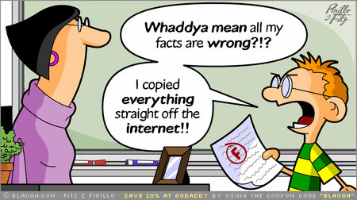
Activity 5: Plagiarism

Slide 24
Avoiding accidental plagiarism
Make sure you fully understand what constitutes plagiarism at a UK university
Close books before you start writing, even if you are just writing notes!

Slide 25
Some useful references:
M. Riley, R. Wood, M. Clark, E. Wilkie and E. Szivas, Researching and Writing Dissertations in Business and Managements, Thomson Learning, 2001
M. Saunders, P. Lewis and A. Thornhill, Research Methods for Business Students, Prentice Hall, 2007
S. Cottrell, The Study Skills Handbook, Palgrave, 2008
N. Proudlove, Guidance on Submission Styles, BB9 Contact: Julia Handl, j.handl@mbs.ac.uk F39, MBS East

