Slide 1
Operations Strategy and Performance

Slide 2
Ops Strategy

Slide 4
OM Strategy Focuses
Price
Quality
Time
Flexibility
Service
Location

Slide 5
Issues to think about when forming OM Strategies
Globalization factors
Order qualifiers
Order winners
Quality-based strategy
Time-based strategy

Slide 6
Performance

Slide 7
Performance Objectives
Cost
Speed
Dependability
Flexibility
Quality

Slide 8
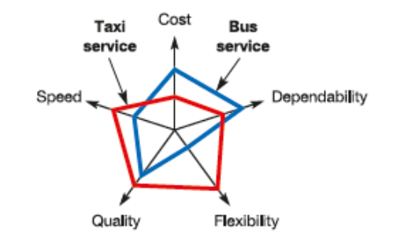
Polar Diagrams

Slide 10
Productivity

Slide 11
Measures
Partial Measure
Output/(single input)
Multi-Factor Measure
Output/(multiple inputs)
Total Measure
Output/(total inputs)
Q: How would you measure productivity growth?

Slide 12
Calculation Example
7040 units produced
Cost of labor – Tk. 1000
Cost of materials – Tk. 520
Cost of overhead – Tk. 2000
MFP?
Productivity of Labor?

Slide 13
Key Factors Affecting Productivity
Standardization
Quality
Technology
Inefficiency
Scrap Rates
Worker Turnover
Work Environment
Motivation

Slide 14
Improving Productivity
Measure
Identify bottlenecks
Tools for Improvement
SMART goals
Strategic alignment
Productivity is not efficiency

