Slide 1
DSS Concepts, Methodologies and Technologies

Slide 2
Objectives
1
Components of DSS
2
Classification of DSS

Slide 3
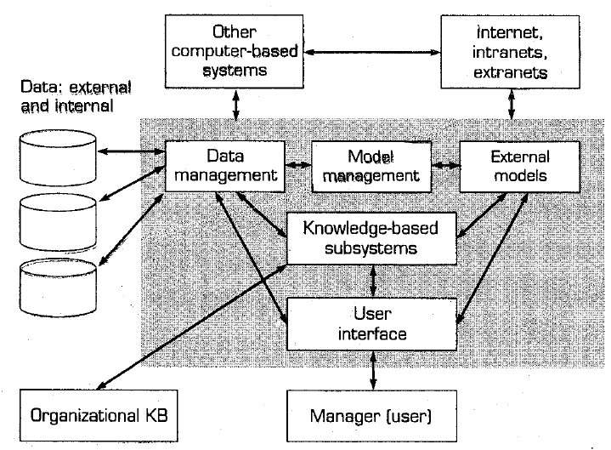
Components of DSS

Slide 4
Components’ Capabilities
Component Name | General Capabilities
Data | Access to a variety of data sources, types and formats for a variety of problems and contexts
Model | Access to a variety of analysis capabilities with some suggestion or guidance available
User Interface | Easy to use and for routine use, modification and construction of DSS
Knowledge | Access to a variety of artificial intelligence tools to provide intelligence to the other three components and to mechanisms for problem solving directly

Slide 5
The Data Management Subsystem
The data management subsystem is composed of the following elements:
DSS Database
DBMS
Data Directory
Query Facility

Slide 6
Key Database and DBMS Issues
Data Quality
Data Integration
Scalability
Data Security

Slide 7
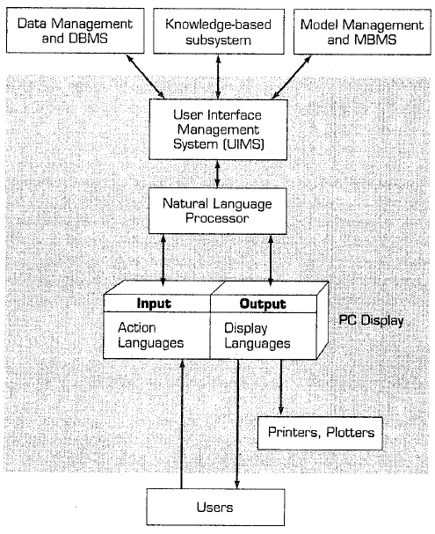
The Use Interface Subsystem

Slide 8
The Knowledge-based Management Subsystem
Advanced DSS are equipped with a component called a Knowledge-based Management Subsystem.
This component can supply the required expertise for solving some aspects of the problem and provide knowledge that can enhance the operation of other DSS components.
Knowledge components may be provided by Expert Systems, neural networks, intelligent agents, fuzzy logic, case-based reasoning systems and so on.

Slide 9
The Knowledge-based Management Subsystem
Expert Systems
https://www.youtube.com/watch?v=gwWLkk4OPAQ
Neural Network
https://www.youtube.com/watch?v=i6ECFrV_BVA
Intelligent Agent
https://www.youtube.com/watch?v=o1GxTa_9wi4
Fuzzy Logic
https://www.youtube.com/watch?v=J_Q5X0nTmrA

Slide 10
Classification of DSS
Text-oriented DSS
Database-oriented DSS
Spreadsheet-oriented DSS
Solver-oriented DSS
Rule-oriented DSS

Slide 11
End of Class

