Slide 1
Financial Risk Exposures

Slide 2
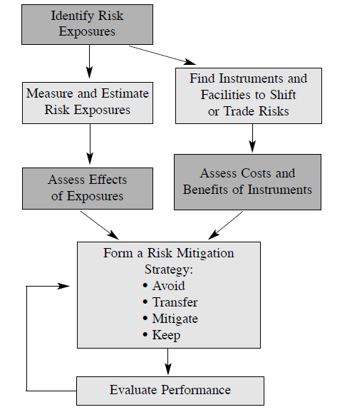

Slide 3
Financial Risk
Expected Loss vs Unexpected Loss
Gain and Loss Distributions
Identification of significant factors and their relationships
Interesting Examples
Default Risk Correlation – Credit Cards vs Corporate Loans
The real estate credit crisis

Slide 4
VAR- The basic
Gain and Loss Distributions
Confidence Intervals
The problem with VaR

Slide 5
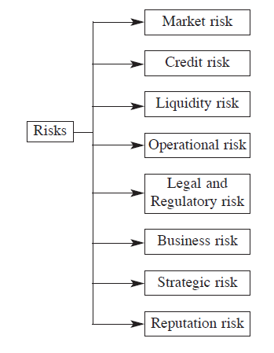
Typology of Risk

Slide 6
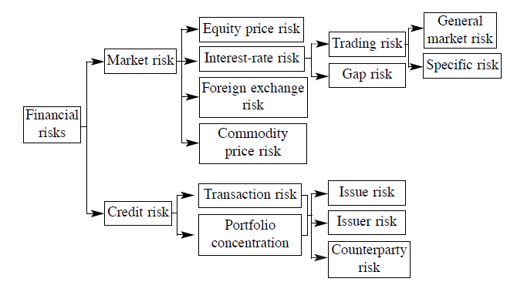
Primary Focus

Slide 7
Any problems with categorizing?

